Slide 1


BIG DATA

Slide 2

CHAPTER-1
Distributed Learning

Slide 3
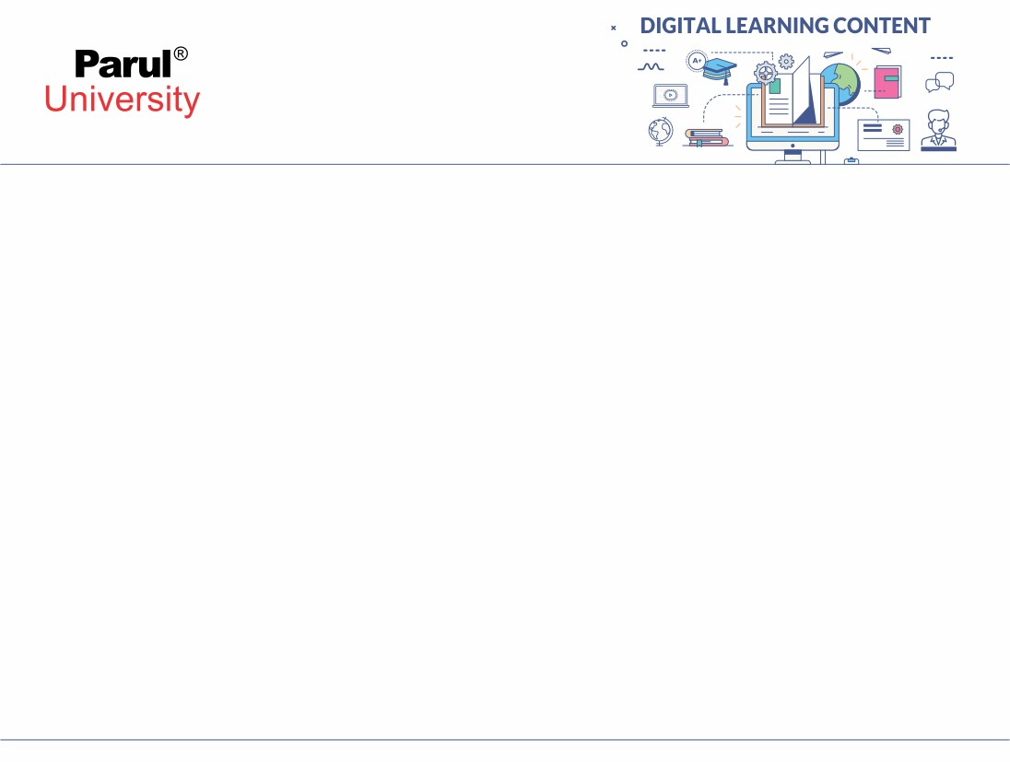
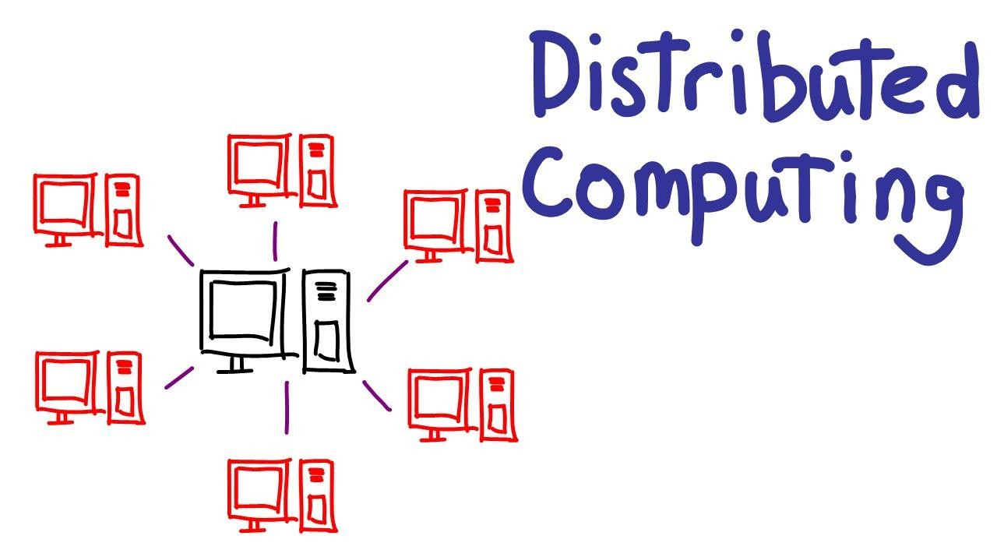
What is Distributed System?
A distributed system, also known as distributed computing, is a system with multiple components located on different machines that communicate and coordinate actions in order to appear as a single coherent system to the end-user.

Slide 4
Advantage of Distributed System
Can easily share data among themselves.
Easily can added nodes.
Failure of one or more node do not lead to the failure of distributed system.
Resources can be shared with every nodes.

Slide 5
Disadvantage of Distributed System
Difficult to provide security in distributed system because to make the system secure the nodes as well as the connection should be secured.
Some message and data can be lost in the network while moving from one node to another.
when database is connected with distributed it is become complicated.
Overloading may occur if all the node send data at the same time.

Slide 6
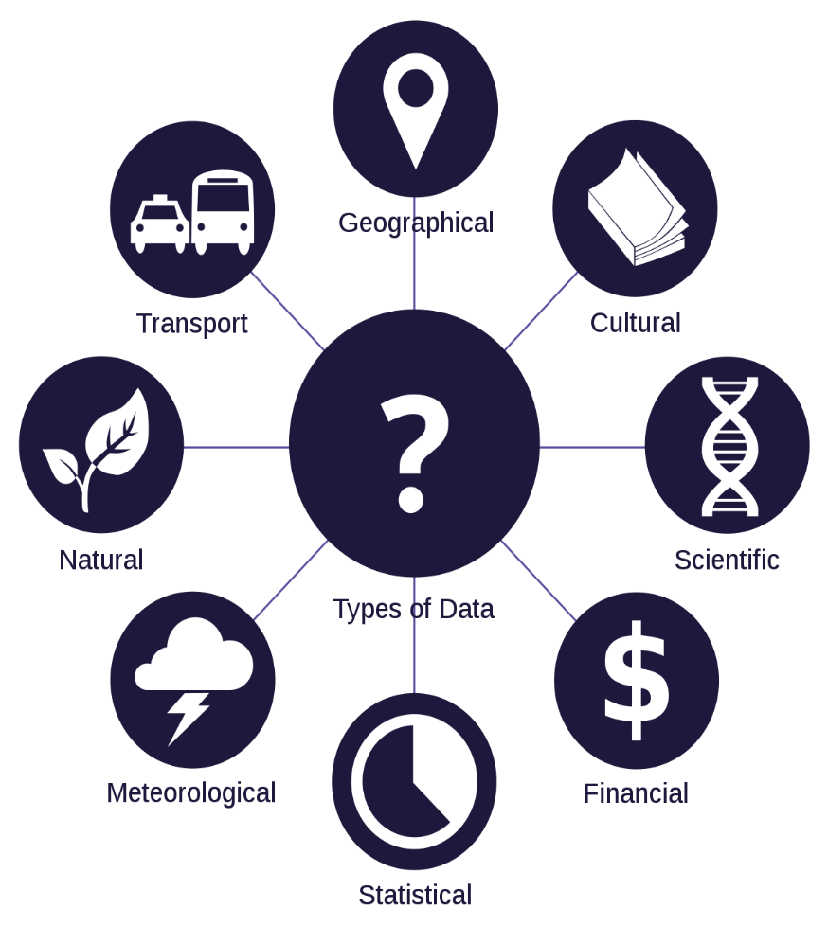
What is Data?
Data are quantities, characters, or symbols
Computer performed operation on quantifiers, characters or symbol.
It may be stored and transmitted in the form of electrical signal.
It can be also recorded on
magnetic recording media.

Slide 7
Big Data
Big Data is also data but big in size.
Big data is a data which is huge in volume and still growing exponentially.
Ex:
New York Stock Exchange
Social Media
Jet engine

Slide 8
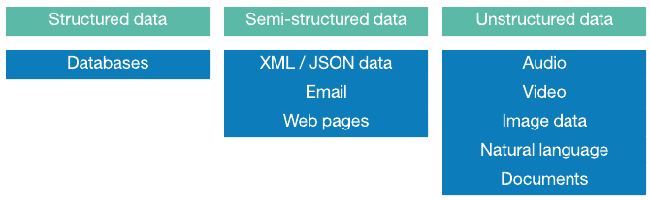
Type of Data
Structured
Unstructured
Semi Structured

Slide 9
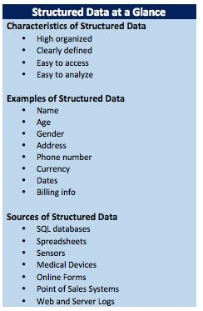
Structured Data
Any kind of data that are stored in a predefined format are known as structured data.
Predefined format : DBMS
It is well organized.
Easily used by machine learning algorithm, easily used by business user.
Because of limited storage options.

Slide 10
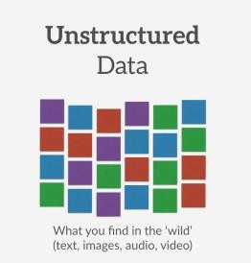
Semi Structured Data
Semi-structured data is like unstructured data but it contains metadata.
Mata data contains information of the data.
With the help of metadata the data is easily accessable,analized like structured data.

Slide 11
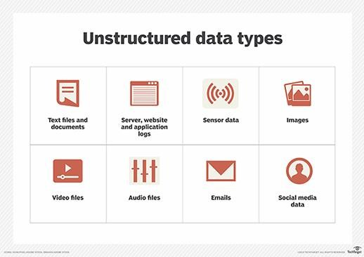
Unstructured Data
The data which are stored in a random format, it is not processed until it is used.
Freedom to store in any format, faster accumulate rate.
Require expert data scientist,
specialized tools.

Slide 12
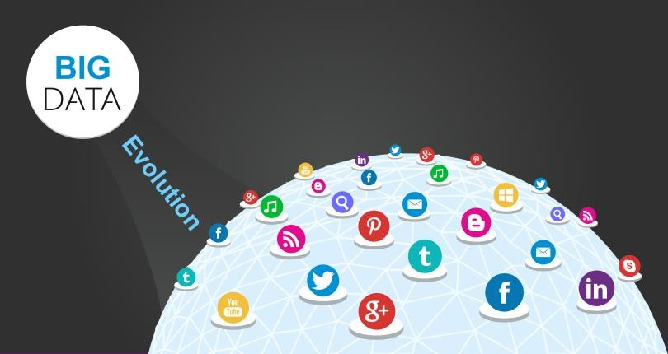

Slide 13
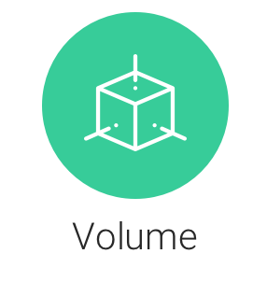
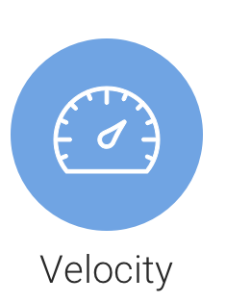

Three Characteristic of Big Data
Volume : Volume refers to the amount of data generated through websites, portal and online application.
Velocity: Velocity refer the speed by which data is generated. Like facebook,google,twitter many other social media create data every day.
Variety: Variety refers to all structured and unstructured data that are generated by human or machines.

Slide 14
Challenges of Big Data
Lack of proper understanding of Big Data: As it is new technology ,there is insuffient understanding of the Big Data.
Data growth issues : As it growing rapidly , to
store such amount of data is huge task.
Confusion while Big Data tool selection: As it is new professional
Lack of data professionals
Securing data

Slide 15
Why Big Data?
Data driven decisions provide advantage : Studies have shown that data driven decision are more effective than human generated decision. Big Data help the organization to know the trends and pattern that can be used for future benefit.
Big Data provides a spring board for AI: Artificial intelligence (AI) is the most desire areas of expertise in business today. Big Data acts like food for the AI projects. For running AI algorithm it require a large amount of data which it get from Big Data.
Big Data Demand: As every day new technology is coming in the market. All this technology is creating or required data. In both the situation high demand of big data expert is in the market.

Slide 16
Why Big Data Analytics?
Risk Management :Big Data analytics to identify fraudulent activities and discrepancies.
Product Development and Innovations: Big Data analytics to analyze how
efficient the product design and whether there is any scope of improvement.
Quicker and Better Decision Making Within Organizations: Big Data analytics uses features of the data and give a quicker and better decision than human.
Improve Customer Experience: Big Data analytics analyse the feedback of the customer so that they can improve the experience of the customer by improving their product and service.

